Slide 1







Circular Economy Hubs for the Creative Sector
Briefing note by
Founding partners of ReStage
restage.org.uk
August 2025

Slide 2

What we did
Summary
This report pulls together the key themes and data gathered from the survey, case studies, presentations by the hubs and the workshop.
From this information, we have a better insight into the emerging sector and which resources would support the less established players.
Activity is primarily volunteer-led and is most often in insecure locations and making use of unsuitable spaces.
Investment in both the physical and digital infrastructure for reuse as well as skills, networks and logistics is needed for re-use in the creative sector to become mainstream.
There are some well-established hubs with clear interest in sharing lessons learnt and there is strong interest in a network of practice and support.
Hubs are keen to support work to build an evidence base for action and investment into the sector.
This is a young sector with a lot of energy and desire to share learnings and create social and environmental impact.
1
3
Online survey created to help us understand and map circular/creative hubs.
Online workshop for the 20 circular/creative hubs who responded to share survey results and for each hub to introduce their work and the barriers and opportunities they face.
2
4
Survey distributed through social media by ReStage and our partners.
Locations of all hubs mapped and share with case studies on our website
www.restage.org.uk/hubs
restage.org.uk
XX August 2025

Slide 3

Key themes
From the survey there were some key themes that emerged. These were:
Space
Operations
Funding
The sector currently has lots of precarious and unsuitable space. A suitable and larger space is therefore required in London.
Operations are currently largely undergone using voluntary and unskilled time, with newly emergent frameworks for how standard procedures needing development.
With the pitfalls identified from the other themes, organisations are struggling to reach a smooth operational scale. Collaboration and cohesion would form the groundwork for larger funding pots.
Process and Material Flow
Measuring Impact
With so many emergent organisations, there is no clear process set for the industry, which brings a lack of clarity how to engage.
Measuring varies widely within the sector. It needs cohesion of financial tracking alongside material and social tracking to form a framework for the industry.
restage.org.uk
XX August 2025

Slide 4


survey response
Access to space
Spaces used by these organisations are often inappropriate. They are often meanwhile or with short leases and not always set up for the scale of operations (ie, poor large vehicle access, small doors, first floor or too small).
44% consider their site to be “at risk” and do not have long term access to a consistent space for development.
Almost half have leases that are less than 3 years and have limits to fit out capacity to ensure a safe and suitable working environment for growth.
A lack of stable ownership of space is limiting the growth of the sector, as operating at scale often increases the viability of organisations as a whole.
“We are about to move sites into a much larger facility, this will help our financial positioning”
restage.org.uk
XX August 2025
Organisations’ current lease length

Slide 5
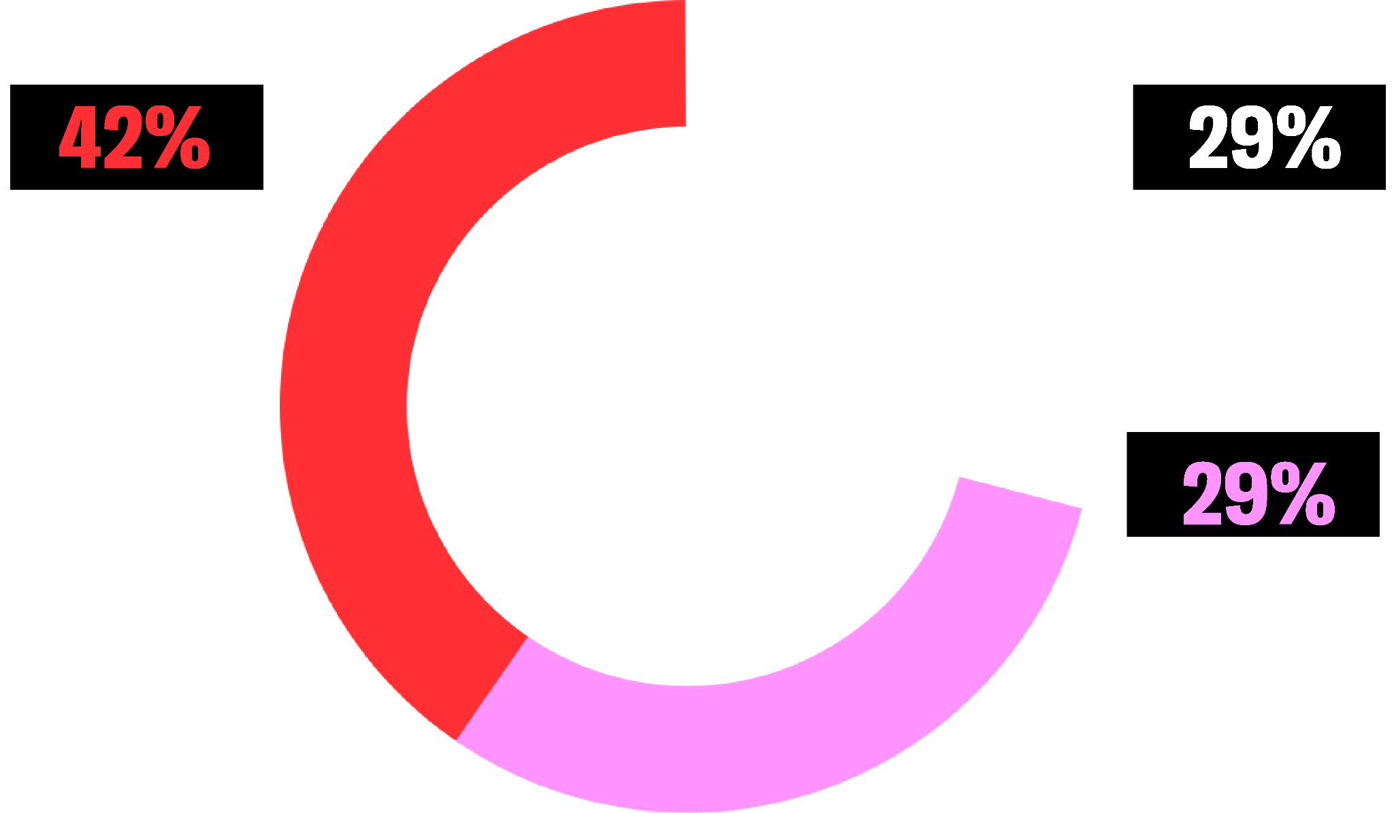
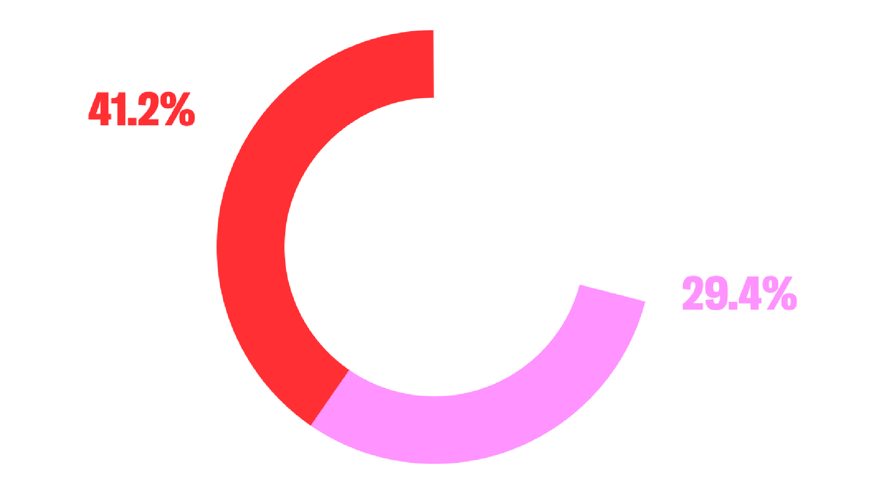
ReUse Hub Operations
These sites are often volunteer led, or as an additional unpaid remit to an existing role.
As a result of this, knowledge gaps exist without the proper training between sector and end user. Training opportunities are vast but under resourced.
Where smaller stand-alone organisations have the practical knowledge, they do not have the benefit of direct funding/access to space as readily.
Transportation and access to users is an ongoing issue. There are upfront costs attached to effective transportation that could increase scalability but are not viable without funding.
(see funding)
Organisations’ current project status
“It’s bloody hard to do
the right thing and to
still make it viable”
restage.org.uk
XX August 2025

Slide 6
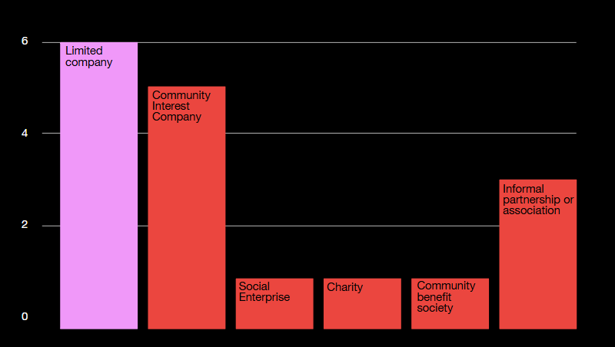
Governance & Funding
Money is an ongoing issue, with impact on wider aspects of operations (ie short term leases, space ownership, effective transportation
costs etc).
With bootstrapping as the primary method of managing stand-alone spaces, scope for growth is slower.
Suggested financial models may work elsewhere, but are not sector specific or appropriate. There is huge enthusiasm for embedding circular economy models but fewer grant funding pots to apply for.
Organisations are covering their own costs by charging for services to meet those costs, but are still trying to balance the impact they want to deliver with the need to pay for their services.
There’s a keenness to explore social enterprise models and share knowledge on potential learnings for the profit and impact combination models.
Two thirds of circular/ creative hubs are not profit led but mission lead primarily. Just under half of which are community interest companies.
“We would like to be part of a network that shares ideas and pitfalls in this process”
restage.org.uk
XX August 2025
Organisations by type

Slide 7
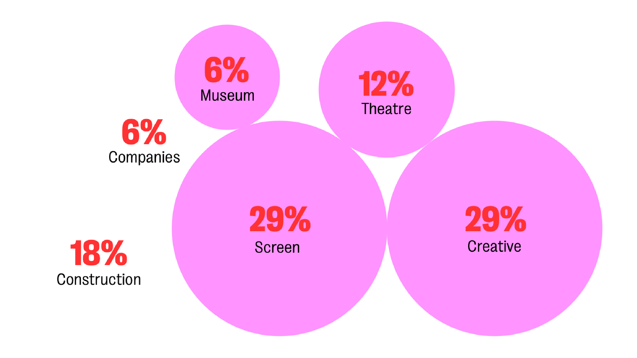
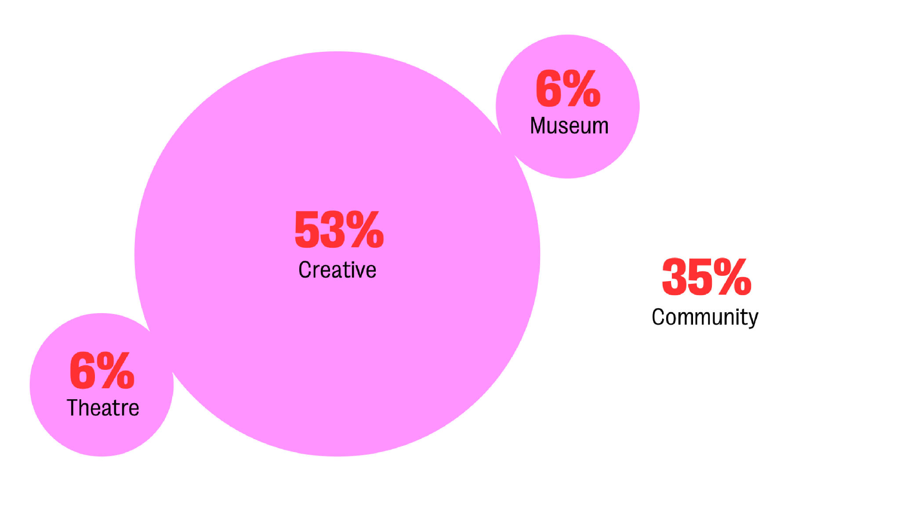
Process &
Material Flows
Processes are currently unclear both for:
industry to engage with circular economy organisations.
collaboration between the circular economies themselves.
This makes the sector less accessible for everyone.
There’s a variety of relationships between organisation and users, (for example industry to community, industry to industry).
There is no established framework or clear pathway examples for new organisations to consider following to foster these relationships.
Of all the materials restaged by
the hubs, just over 75% come from the creative sector and just under 25% come from construction and other companies outside the creative sector.
Blending digital and physical market spaces can be hard to juggle.
We did receive responses from purely digital spaces where
the initiative was an online marketplace format that was primarily user-led.
Pathways to follow for industry must also consider way before ‘end of life’. Design and policy pathways for example must be considered to reduce waste at its core.
This highlights the need for skill development and training opportunities delivered to be delivered by some hubs to ensure a clear user pathway is supported by experienced individuals.
Where materials in the ReUse hub come from
Where materials in the ReUse hub go to
restage.org.uk
XX August 2025

Slide 8
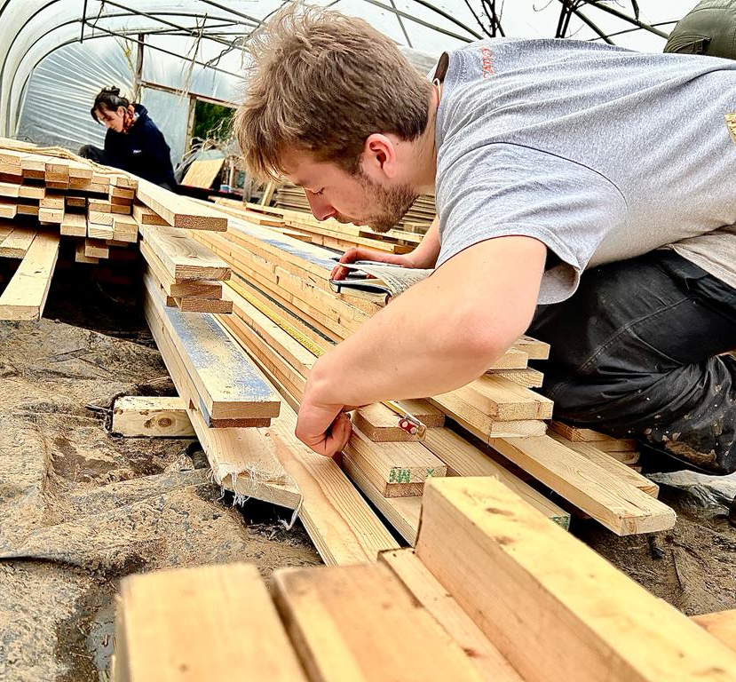
Measuring Impact
Organisations have lots of disparate ways of tracking impact, or no ways at all.
Tracking varies but often includes:
ingoing and outgoing material
tonnage saved from waste streams
carbon diverted from waste streams (some sites are also offering carbon measurement as an add on tool for their clients)
qualitative data like photos and stories
tracking vehicle trips and transport emissions (including electric vehicle use)
indicative social impact metric (needs further development)
number of community projects supported through material
‘material journeys’ location of materials from/ to
skip costs saved
resale values (dependent on productions IP protocol.)
There is appetite to develop together or have access to a central framework for process.
Logging individual items is often manual and can be a huge undertaking, but is vital to support the case for the positive impact of the circular economy services and make the sector much more efficient.
Establishing a standard practice of tracking and measuring impact will allow collaboration between organisations and allow clear pathways for new organisations to join the growing sector.
A standard practice framework will also mean sites reuse process is clear and efficient and material is not allowed to stagnate in storage.
Further exploration would be helpful to establish:
how many existing organisations have their own collection and transport services
“We don’t (measure) yet. We’d like to develop a social impact metric which can measure the social value of a single piece of material. We would like to develop this social metric in collaboration with others’”
restage.org.uk
XX August 2025

Slide 9
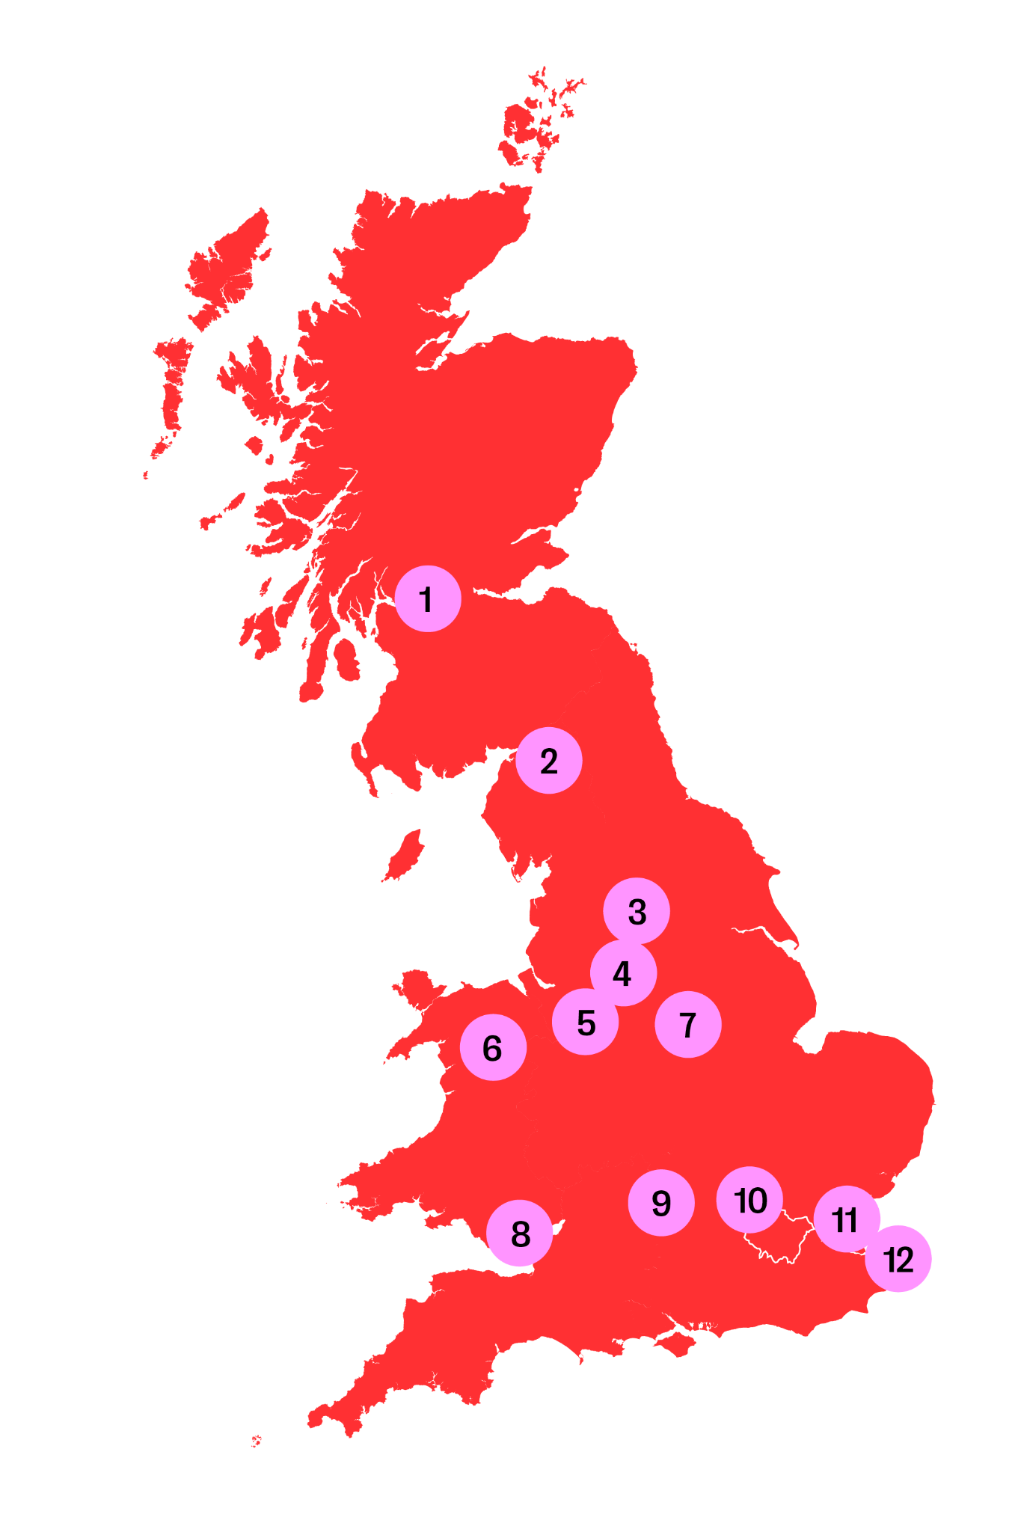
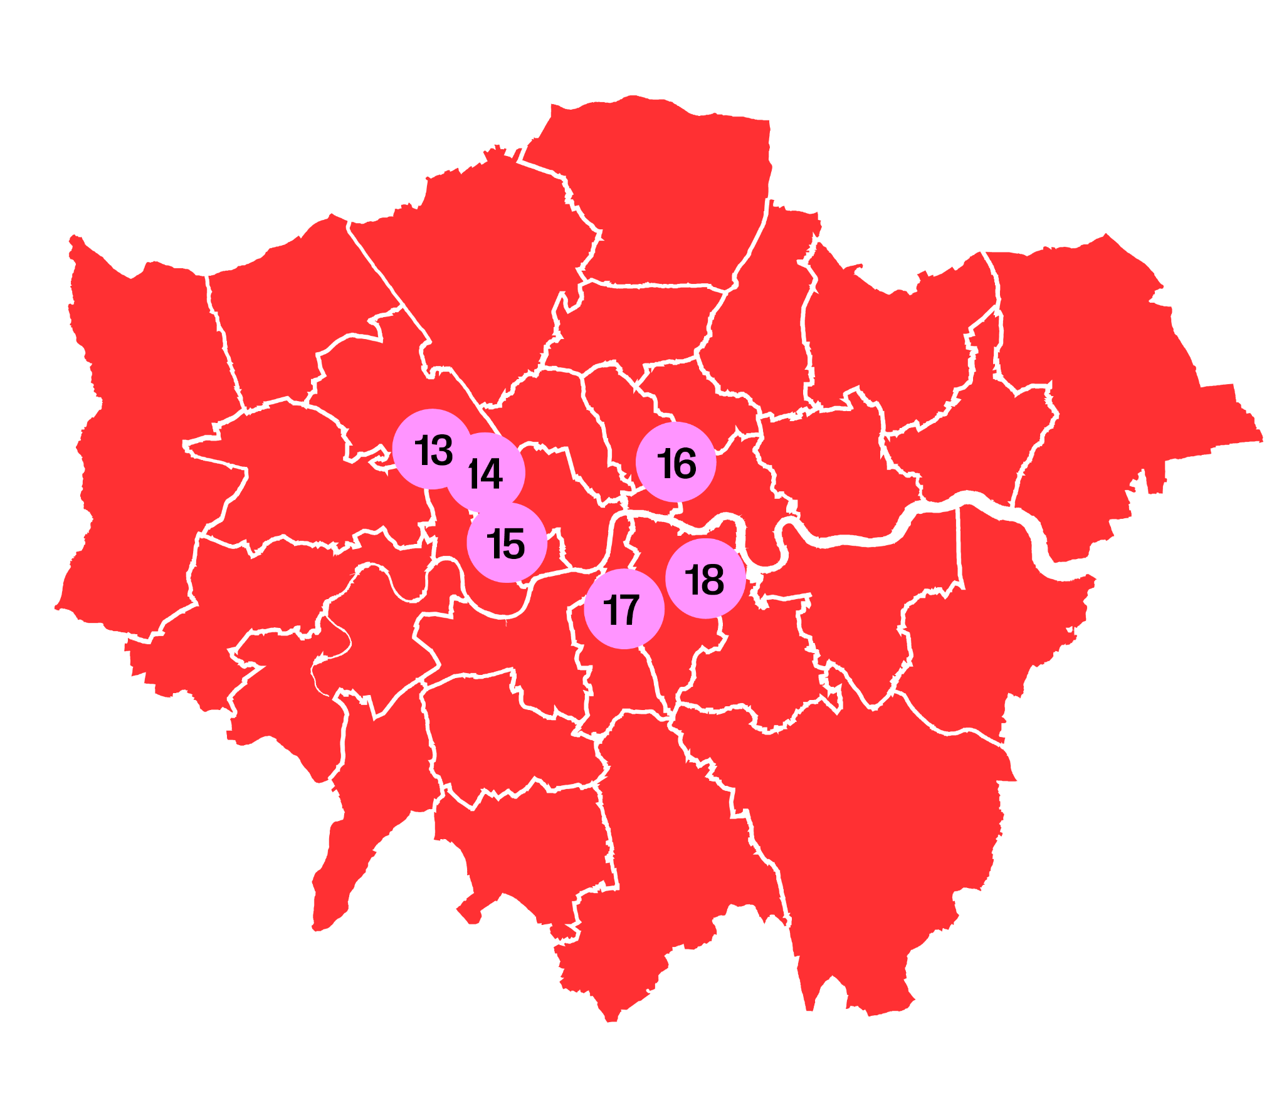
So what?
1 Re-Set Scenery
2 Rebuild Carlisle
3 Resource Hub
4 Entertainment Storage
5 Stockyard & Stockyard North
6 Hwb Gogledd Cymru
7 Rocket Storage
8 Get Set Cymru
9 Set-A-Side Re-use/Re-purpose/Recycle
10 Sky Sustainable Productions Hub
11 AssetCycle
12 Circular Margate
ReStage’s website directory has emerged from this survey, this is an essential asset to connect projects together as a first step.
Recognising the importance of cohesion and collaboration in addressing the pitfalls outlined here, the network should consider the following lessons:
“Start with reuse”
imagine if all productions started with a trip to a re-use hub to start the design process with reuse.
“Make it modular”
Modular elements are considerably easier to reclaim and reuse, creating a simpler reclaim model.
“Plan to pass it on”
Consider material earlier on in the cycle, advocate for designing for deconstruction and plan time and budget for reuse in the strike.
13 ReCollective
14 Remade in Park Royal
15 South Ken ZEN
16 Renée Materials
17 PropUp Project
18 The National Theatre Green Store
restage.org.uk
XX August 2025

Slide 10
Next steps
Develop the Network and framework for Reuse Hubs
Knowledge exchange & long term change
Connecting circular economy initiatives gives us the opportunity to share promising practices, knowledge and resource.
This network aims to empower the organisations already working in this space to create more impact across the UK and beyond and for creative organisations to prioritise reuse.
Sharing pain points, solutions and insight will create a cross-creative sector initiative that can disrupt efficiently, through consistent practice and in an interconnected way that results in action.
Aims to support supply-led design approach to establish circular economy as go to/best practice in creative industries.
There are some well-established hubs with clear interest in sharing lessons learnt and there is strong interest in a network of practice and support.
Hubs are keen to support work to build an evidence base for action and investment into the sector.
restage.org.uk
XX August 2025

